Slide 1

- Section 3 of 1940 Act defines an “investment company” and regulates the perimeter of entities which fall under the definition: (A) is or holds itself out as being engaged primarily, or proposes to engage primarily, in the business of investing, reinvesting, or trading in securities; (B) is engaged or proposes to engage in the business of issuing face-amount certificates of the installment type, or has been engaged in such business and has any such certificate outstanding; or (C) is engaged or proposes to engage in the business of investing, reinvesting, owning, holding, or trading in securities, and owns or proposes to acquire investment securities having a value exceeding 40 per centum of the value of such issuer’s total assets (exclusive of Government securities and cash items) on an unconsolidated basis. - Some Exceptions / exemptions from above definition: Private funds offerings, wholly-owned finance subsidiaries, certain real-estate funds, certain issuers of asset backed securities - Section 5 of the 1940 Act classifies management companies: ** “Open-end companies” (issues redeemable securities in a continuous offering), or “Closed-end companies” ** “Diversified companies” (> 75% in in money market, government and corporate securities and not more than 5% invested with a particular issuer and not more than 10% of any issuer voting securities) and “Non-diversified companies” - Mutual Funds, ETFs, Unit Investment Trusts, Master/Feeder, Fund-of-Funds fall within the scope of the 1940 Act
09th December 2016 – US FINANCIAL ENGINEERING
WHAT IS A US « INVESTMENT COMPANY » ?
Mutual Funds: Generally a company (corporation, business trust, partnership, or LLC) that issue securities and is primarily engaged in the business of investing in securities

Slide 2
- Section 8 of 1940 Act require funds to disclose: Use Of leverage Concentration in industry < 25% Making loans Investing in real estate and commodities - Fundamental change in investment policy: Change from “diversified” to “Non-diversified” need shareholder approval Change in investment policies linked to: leverage, concentration, real estate, commodoties, loans, etc… need shareholder approval - Fund disclosure requirement on parameters, risks, fund management and other policies Rule 35d-1: Name test rule Name cannot be “misleading” Name suggesting investment in certain investments or industries or in certain countries or geographical regions or tax-exempt funds Must adopt policy to invest at least 80% of total assets in type of investment or region May not change policy unless disclose in prospectus fund will provide 60-days prior written notice to shareholders of such change
09th December 2016 – US FINANCIAL ENGINEERING
WHAT IS A US « INVESTMENT COMPANY » ?
SPECIFIC DISCLOSURE REQUIREMENT FOR INVESTMENT COMPANIES ISSUES

Slide 3
- 1940 Act funds can invest in a wide variety of investments, including other funds (subject to limitations - A fund may but is not required to designate its investment objective as fundamental (one that may only be changed upon shareholder approval) - Limitations on Leverage 1940 Act prohibits complex capital structures by limiting funds use of leverage Section 18 limits issuance of “senior securities” Mutual fund may only borrow from a bank, subject to 300% asset coverage Any future obligation to pay violates Section 18 unless fund “covers” the obligation - Related Party Transactions: Section 17 of the 1940 Act contains a number of prohibitions on transactions between fund and fund insiders or affiliated organizations No direct transaction with affiliates No joint transactions where fund and affiliate acting together with respect to a third party -Liquidity Mutual funds cannot invest more than 15% of assets in illiquid securities Illiquid securities are those that cannot be readily sold at their approximate value within 7 days ( Redemption requests must be met within 7 days
09th December 2016 – US FINANCIAL ENGINEERING
WHAT IS A US « INVESTMENT COMPANY » ?
ELIGIBLE INVESTMENTS AND TRANSACTIONS

Slide 4
- “Diversified fund” (defined in Section 5(b) of the 1940 Act) At least 75% of total assets must consist of cash, cash items, government securities, securities of other funds and investment securities Not more than 5% invested in any one issuer Not more than 10% of the voting securities of any one issuer - Internal Revenue Code Subchapter M (under this chapter the mutual fund saves taxes on investment income, dividend, capital gains: At least 50% of total assets must consist of cash, cash items, government securities, securities of other funds and investment securities No more than 5% invested in any one issuer No more than 10% of the voting securities of any one issuer No more than 25% invested in the security of any one issuer (other than government securities or the securities of other funds), the securities of 2 or more issuers that the fund controls and are engaged in similar trades or businesses, or the securities of one or more qualified publicly traded partnerships At least 90% of income/gains distributed to shareholders; 90% to avoid excise tax - Investment in other funds Section 12(d)(1)(A) prohibits a fund from: (i) acquiring more than 3% of a registered fund’s outstanding voting stocks (ii) investing more than 5% of its total asset in a given registered fund (iii) investing more than 10% of its total asset in registered funds in the aggregate
09th December 2016 – US FINANCIAL ENGINEERING
WHAT IS A US « INVESTMENT COMPANY » ?
DIVERSIFICATION RULES

Slide 5
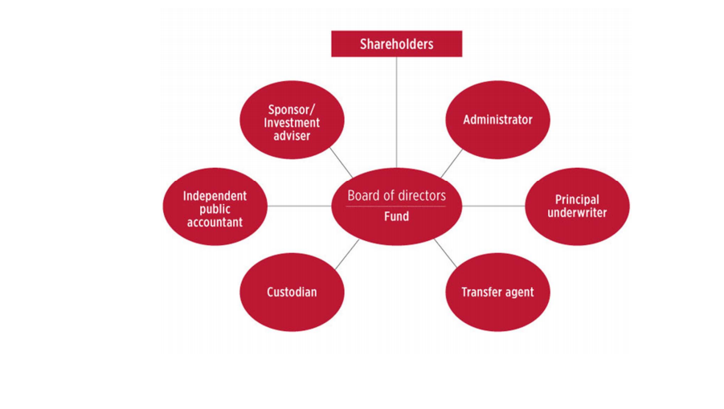
09th December 2016 – US FINANCIAL ENGINEERING
INVESTMENT COMPANIES SERVICE PROVIDERS AND GOVERNANCE
SET UP

